Slide 1
Linked List

Slide 2
AGENDA
Introduction
Types of Linked List
SLL – Introduction
DLL – Introduction
CLL – Introduction
Implementation
Operations
Basic Problem

Slide 3
INTRODUCTION
Definition of a linked list:
A linked list is a linear data structure where elements are stored in separate objects called nodes. Each node contains data and a reference (link) to the next node in the sequence.
Why linked lists are used:
Linked lists are used when the size of the data is unknown or can change dynamically.
Basic structure of a linked list:
A linked list consists of nodes where each node contains data and a reference (next pointer) to the next node.

Slide 4
Types of Linked Lists
Singly linked list:
In a singly linked list, each node has a reference only to the next node.
Doubly linked list:
In a doubly linked list, each node has references to both the previous and next nodes.
Circular linked list:
In a circular linked list, the last node has a reference to the first node, forming a circular structure.

Slide 5
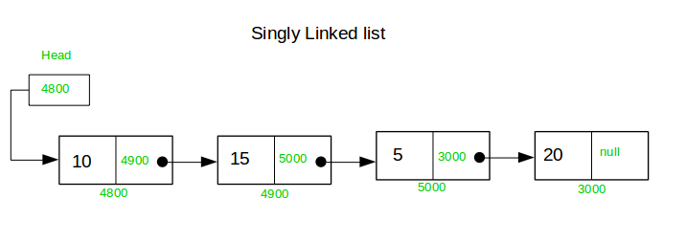

Slide 6
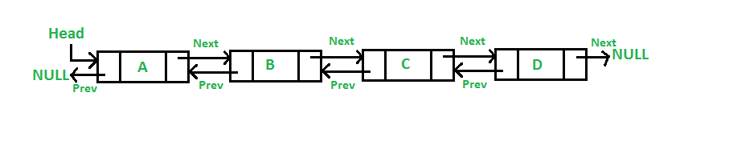

Slide 7
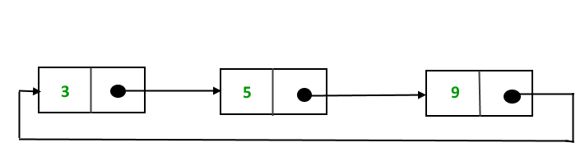

Slide 8
Singly Linked List - Introduction
Definition and characteristics of a singly linked list:
A singly linked list is a collection of nodes where each node has a data field and a next pointer.
Illustration of a singly linked list:
Visual representation of nodes connected via next pointers.
Basic operations: traversal, insertion, and deletion:
Traversal: Visiting each node sequentially.
Insertion: Adding a new node at the beginning, end, or a specific position in the list.
Deletion: Removing a node from the list.

Slide 9
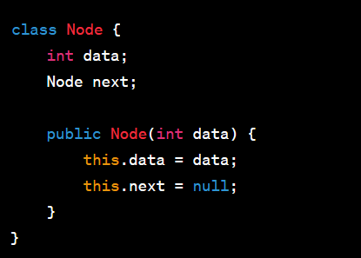
Singly Linked List - Implementation

Slide 10
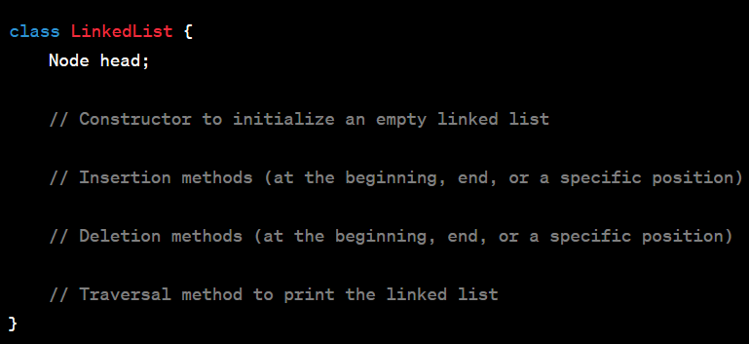

Slide 11


Slide 12
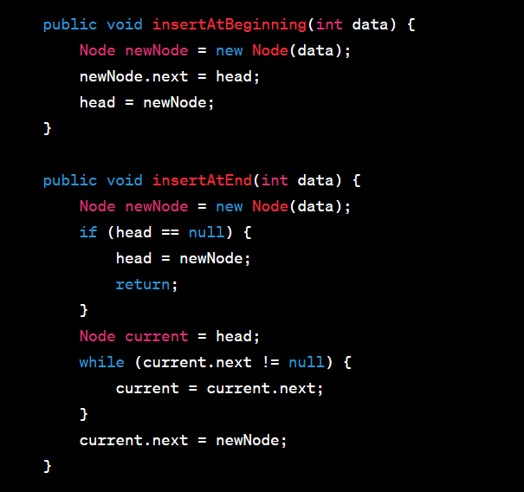

Slide 14
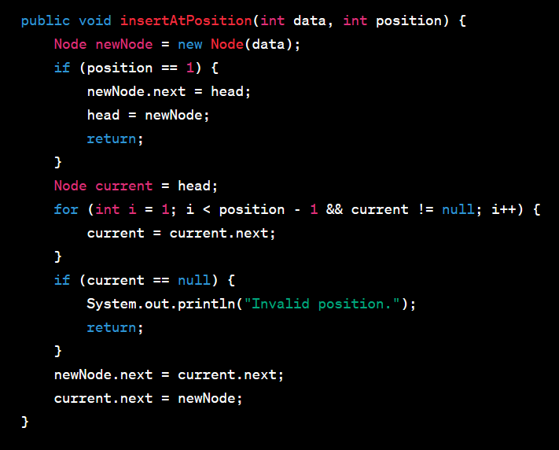

Slide 15
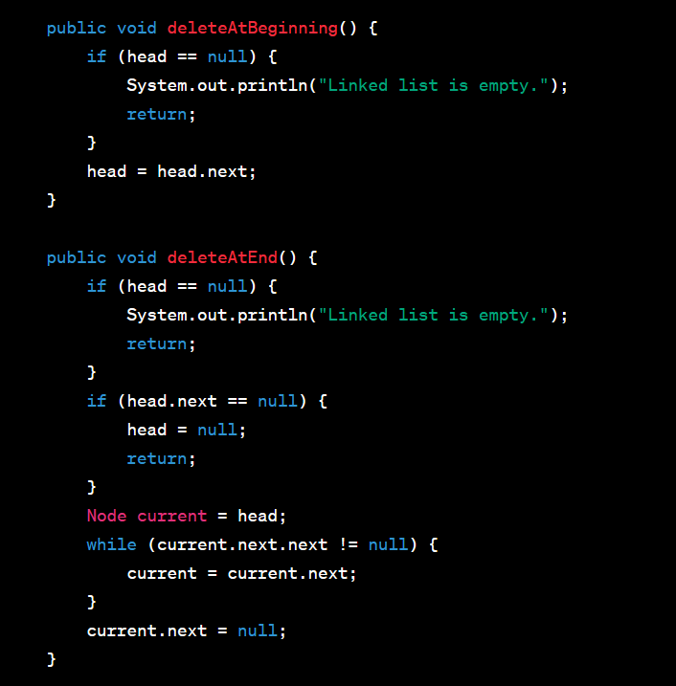

Slide 17
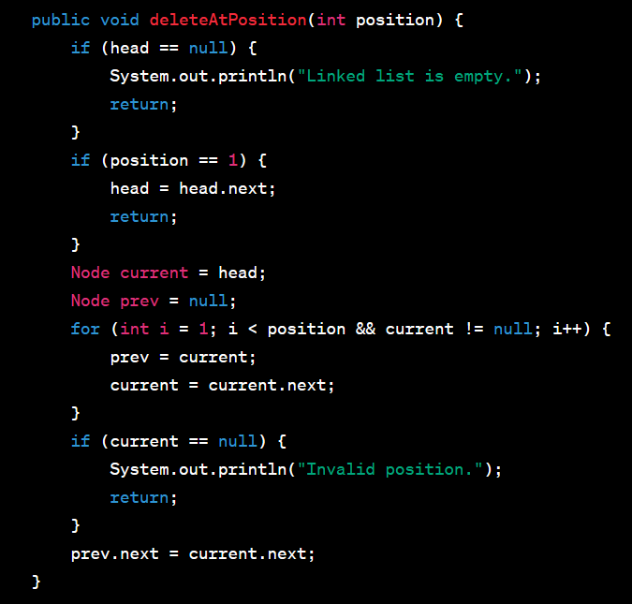

Slide 18
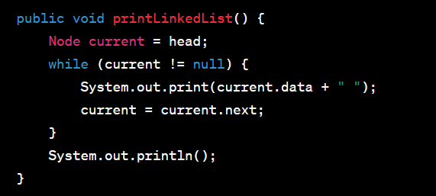

Slide 19
Interview Question
https://leetcode.com/problems/add-two-numbers/

Slide 20
Interview Question - Beginner
Example problems involving linked lists:
Finding the middle element of a linked list:
Traverse the list with two pointers, one moving at twice the speed of the other. When the faster pointer reaches the end, the slower pointer will be at the middle.
Checking if a linked list is a palindrome:
Reverse the second half of the list and compare it with the first half.
Removing duplicates from a linked list:
Use a hash set to keep track of unique elements while traversing the list.

